Slide 1


Making better tactical decisions using the climate forecast tools
Forewarned is Forearmed material is licensed under the Creative Commons Atribution-ShareAlike 4.0 International licensing, with the exception of all trademarks and company logos, and all copyright in all graphs and tables which has been referenced as owned by third parties.
Notes:
Have fun preparing and delivering your FWFA workshop!
Please make sure you
Cross-check the page referencing with the participant handbook you’ll be providing the participants at the start of the workshop;
Replace tool-outputs in slides 27 to 32 with tool outputs relevant to the region/area you’ll be presenting in;
Add in your individualised approach to slides 39 and 40 to teach participants about the application of the tools
Consider any other yellow highlighted text in the slides.
Consider any notes under the slides to help you ensure key messages are shared with the participants at that particular slide.

Slide 2
Welcome
Purpose:
  To assist Australian farmers to better understand forecasting of extreme weather and climate events
  How to use the FWFA tools to make better tactical decisions
Introductions:
  Name, location, greatest weather challenge encountered / which weather app do you use most / … / choose your own introduction approach!
  Housekeeping
Notes:
Don’t forget to hand out the workbooks and mention the option to take notes throughout – the slides have references to participant workbook page numbers for your & the participant’s convenience.

Slide 3
Agenda
Welcome
Overview of forecasting
The five FWFA tools
Using the five FWFA tools
Further resources, feedback
Close

Slide 4
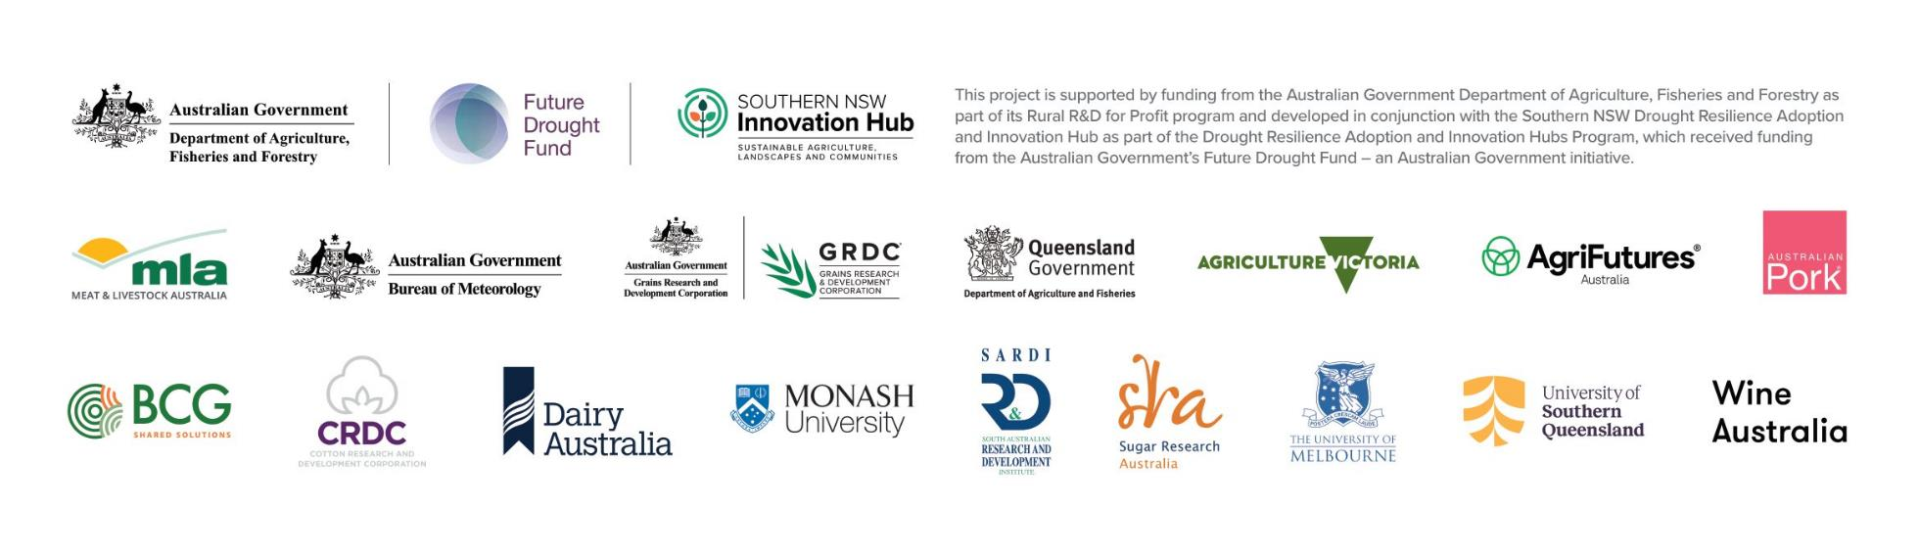
Project partners

Slide 5
Benefits of the new forecasting tools
Fit-for purpose thanks to farmer and industry input throughout the FWFA program.
Free tactical tools to test decisions that build resilience through drought, floods, heatwaves or extreme cold.
Localised information ahead of weather events which help protect your business, animals, crops and people, and capitalise on upsides.

Slide 6
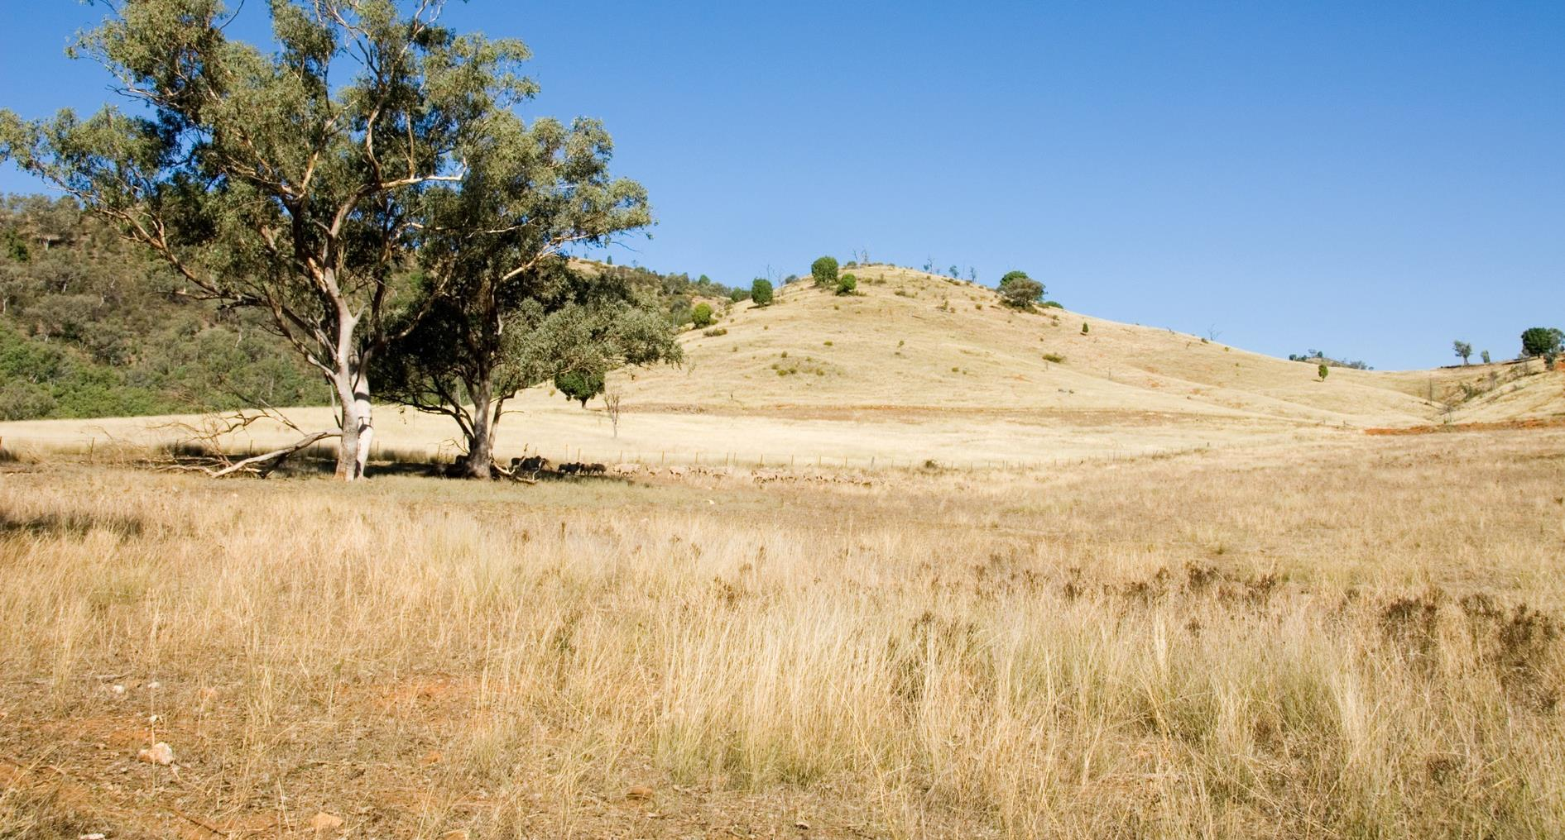

Overview of forecasting

Slide 7



The climate decision gamble
Poker
Chess
Pokies
Photos by Michał Parzuchowski on Unsplash

Slide 8

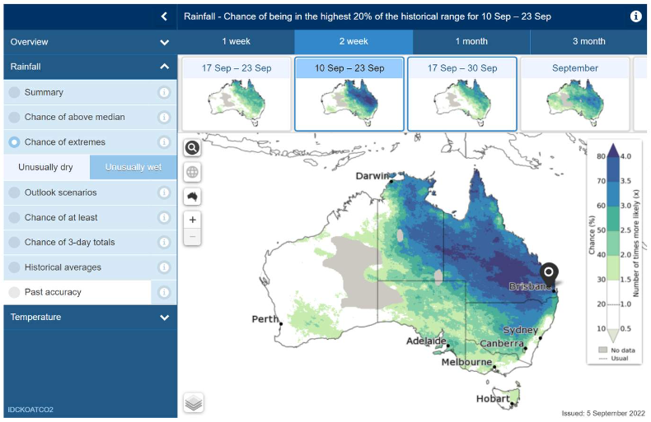
Forecast language
Workbook
Page 2
Weather forecast
  Prediction of weather conditions, for a specific time and place, in the near future
  Next few hours to several days with resolution of 1-2 km
  More accurate as the timeframe for the forecast becomes shorter
  Planning operational activities
Seasonal climate forecast
  Long-term predictions of the average weather conditions for a particular region
  Several months with resolution of 25 km
  Less certain (range of possible outcomes)
  Tactical planning
Multi-week climate forecasts
  Short term seasonal rather than long term weather

Slide 9

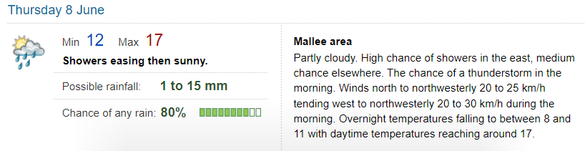
Weather forecast interpretation
Workbook
Page 5
Possible rainfall
  First number: 75% chance of at least
  Second number: 25% chance of at least
Forecast icon
  General condition
  for day or hour
Chance of any rain
  Likelihood of >0.2mm in your area
  20% chance no rain at all

Slide 10
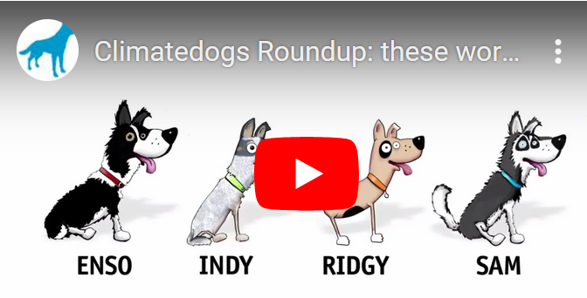
Climate drivers
Workbook
Page 3
ENSO (Enso)
IOD (Indy)
STR (Ridgy)
SAM (Sam)
———
ECLs (Eastie)
MJO (Mojo)
Workbook
Page 3
Notes:
Explain that climate drivers influence Australia’s climate and weather outcomes. The Climate Kelpies website talks about these drivers as Climate Dogs. The climate drivers work together to drive the weather we deal with. They might not always play the game, which is how we end up with our extremes.
Note: climate drivers is not the focus of the workshop. If participants are interested, additional resources are available

Slide 11
The five FWFA tools
Terminology
Notes:
Remember you have shared the pre-learning, prompting participants to familiarise themselves with the content. Use the following slides to clarify this information where necessary and summarise the learnings, to ensure it is fresh in the mind (and understood correctly!) when looking at the tools in the next section.

Slide 12
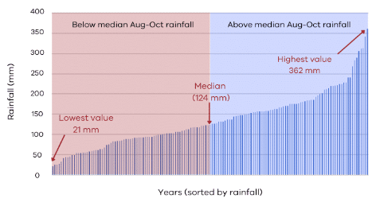
Forecasting language
Workbook
Page 8
Median vs average

Slide 13
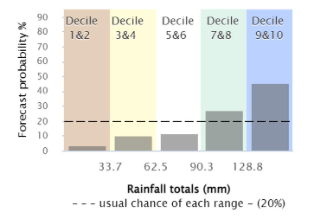
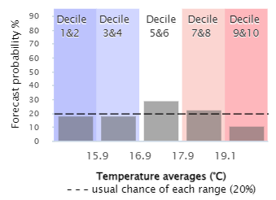
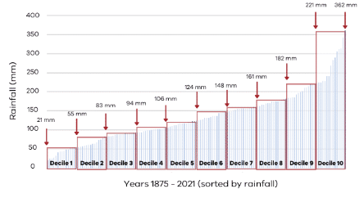
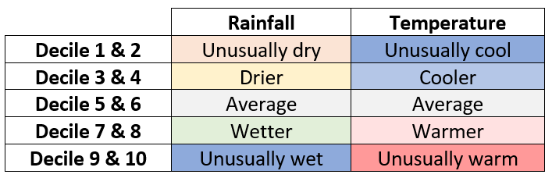
Forecasting language
Workbook
Page 8
Deciles and quintiles
Notes:
Highlight that the colour scheme in the table is used throughout the tools – make sure to point this out when working through the case studies or when driving the website live to work through the tools.

Slide 14
Probability
Workbook
Page 11
Chance of something occurring
Based on 130 year rainfall data, what’s the
chance in any week/month/year of
  Unusually dry (D1&2)?
  “Average” rainfall (D5&6)?
  Unusually wet (D9&10)?
Predictions: 99 model forecast runs
  Unusually dry (D1&2)?
  “Average” rainfall (D5&6)?
  Unusually wet (D9&10)?
Notes:
Answers to the questions on the slide:
Based on 130 year rainfall data, what’s the chance in any week/month/year of
Unusually dry (D1&2)? 20%
“Average” rainfall (D5&6)? 20%
Unusually wet (D9&10)? 20%
The chance of any outcome is 20%. In the previous slide we spoke about a dataset organised from lowest to highest and how the separated in 10% increments make up the deciles. The Bureau’s tools take two deciles together, a quintile, to describe if a forecast outlook is either average (5&6), unusual warm or wet (decile 7&8) or extremely cold or dry (decile 1&2) etc. So the chance that a random value falls into each of these 5 categories is 100% (whole dataset) divided by 5 categories = 20% to fall into any one category.
Predictions: 99 model forecast runs
Unusually dry (D1&2)? About 2-5% (looking at decile 1&2 in the figure)
“Average” rainfall (D5&6)? About 10%
Unusually wet (D9&10)? About 45%
Of the 99 model runs, 45 of these fall into the unusually wet category, which is our forecast probability in this instance. That also means that there is still a chance of 55% that there won’t be an extremely wet event.

Slide 15
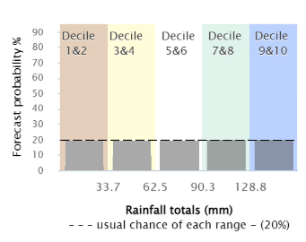
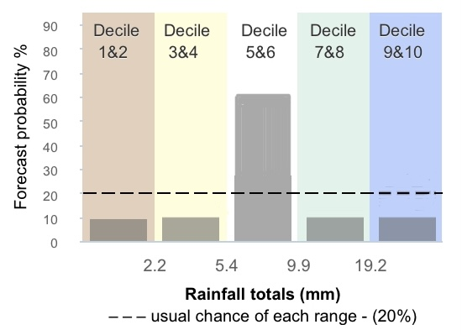
Probability
Workbook
Page 8
Neutral forecast means an equal likelihood that any outcome can be expected
Neutral forecast doesn’t mean average
Neutral forecast
Average forecast
Notes:
A neutral forecast can’t tell you much; the data is not swaying one way or another. Any outcome is just as likely as another!
An average forecast DOES tell you something; there is a higher chance of a median/average (decile 5&6) outlook.

Slide 16
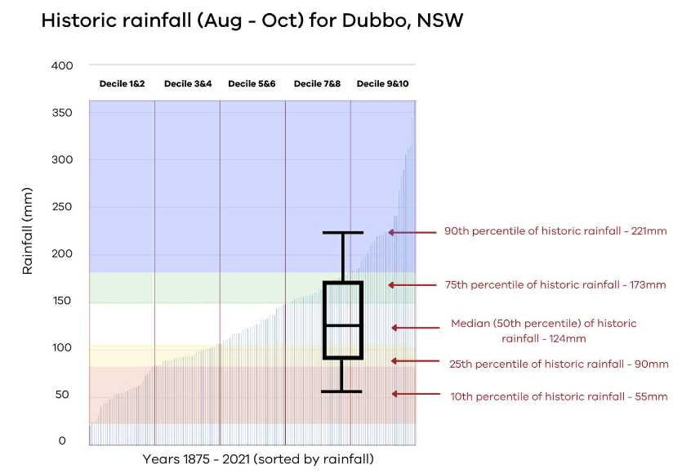
Forecasting language
Workbook
Page 11
Box and whisker plots
Notes:
Focus on explaining that the box and whisker plot is a visual help to understand the spread of forecast data: an elongated box and whisker plots show a big spread in possible outcomes, giving us less confidence than a short and dense box and whisker plot.

Slide 17
Forecast versus hindcast
Workbook
Page 3
A forecast is a prediction of weather conditions, for a specific time and place, in the near future.
A hindcast considers what the weather was like in the past (usually for a period ranging from a few days to several decades).

Slide 18
Model accuracy
Workbook
Page 5
Determines how well a weather prediction model is able to make accurate forecasts of future weather conditions based on past and current data.
Hindcast & forecast
The time of year and location for which the forecasts are made can make a difference.
“Too good to ignore, but not good enough to be sure.”
- Peter Hayman, SARDI
Notes:
Explain that probability and accuracy are not the same; one tells you something about the chance of something occurring, the other tells you about the confidence you can have in the probability presented. Accuracy is determined by how well the hindcast and forecast outcomes overlap.

Slide 19
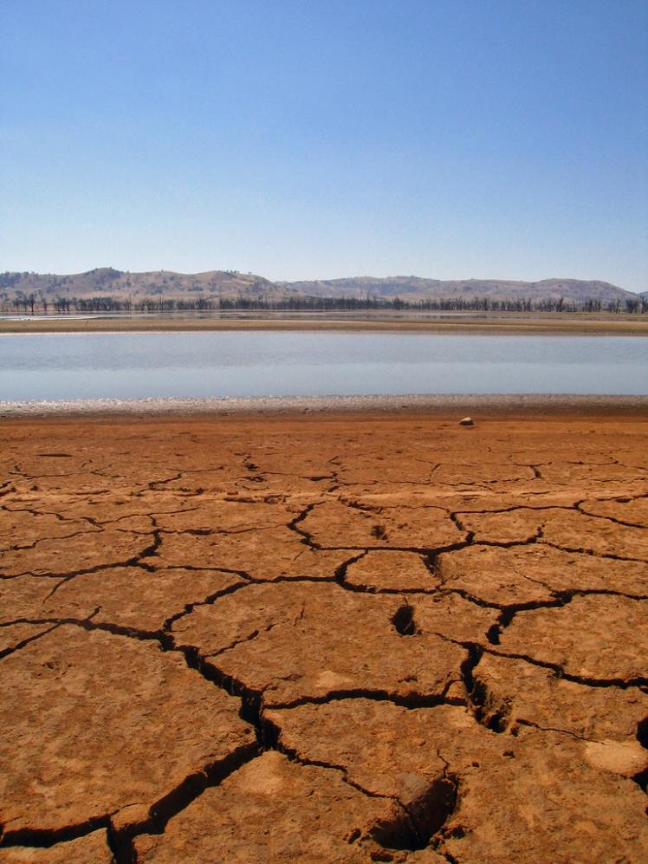
The four key weather extremes
Heat
Cold
Wet
Dry
Image: Tim J Keegan

Slide 20
The five FWFA tools
The tools

Slide 21
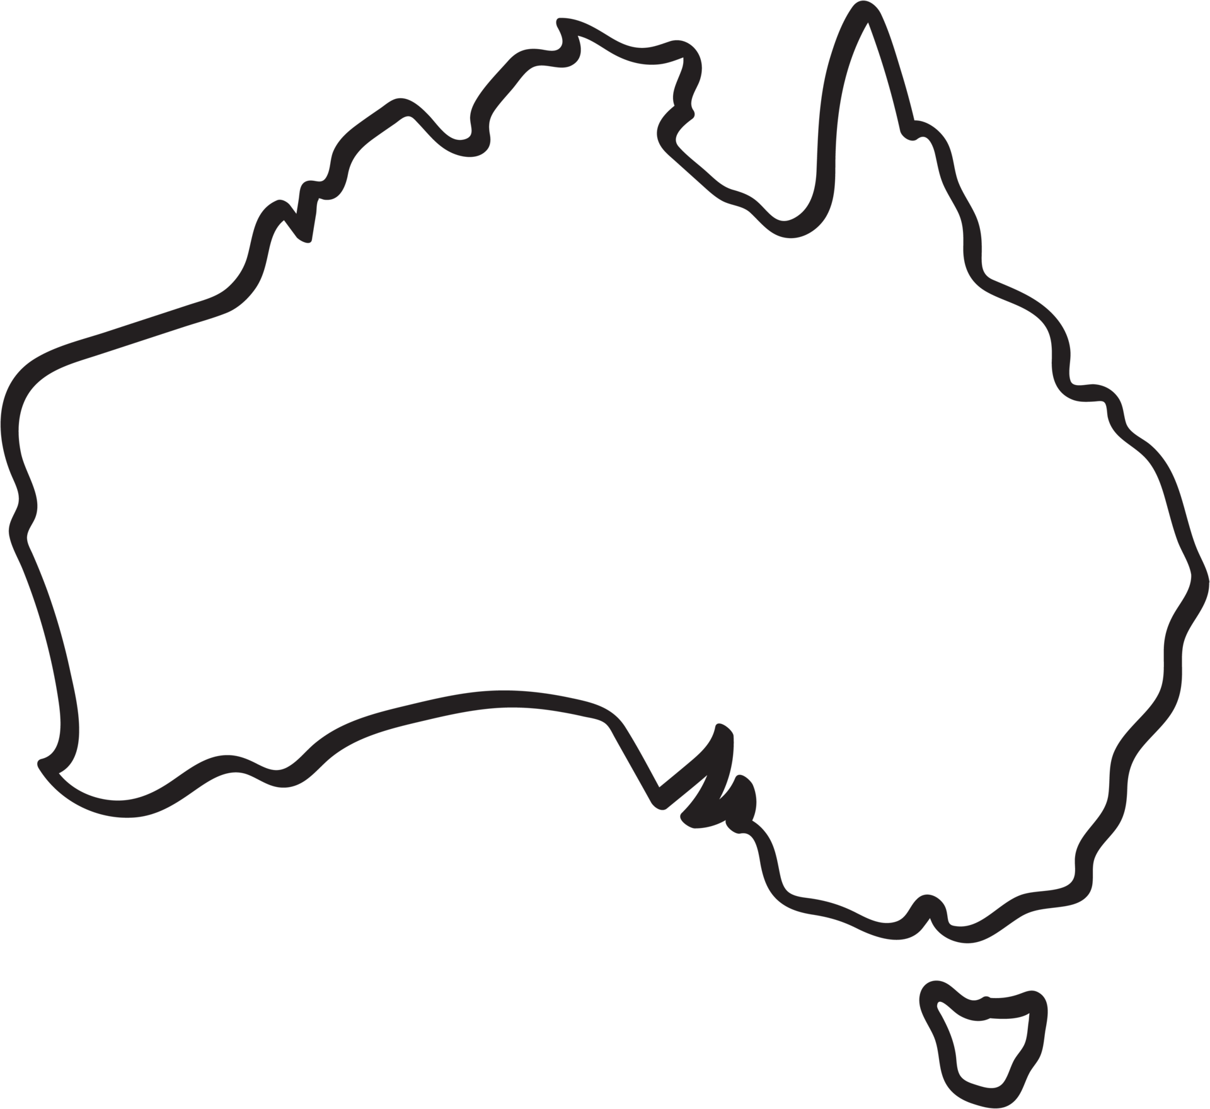

The five FWFA tools
Workbook
Page 12
Tool | Location
1. The chance of extremes maps for rainfall and temperature | Australia-wide
2. The chance of three-day totals maps | Australia-wide
3. The decile bar charts for rainfall and temperature | Location specific
4. The timeline graphs for rainfall and temperature | Location specific
5. The probability of exceedance graphs for rainfall | Location specific

Slide 22
The five FWFA tools
The 5 FWFA climate outlook tools help you plan operations past the seven-day weather forecast by including the decile distribution of forecast model runs and their likelihood.
.
There are two types of tools:
  Australia-wide maps (the chance of extremes and 3-day totals)
  location-specific graphs (decile bar charts, timeline graph and probability of exceedance)
..
They build on the Chance of above median maps.

Slide 23
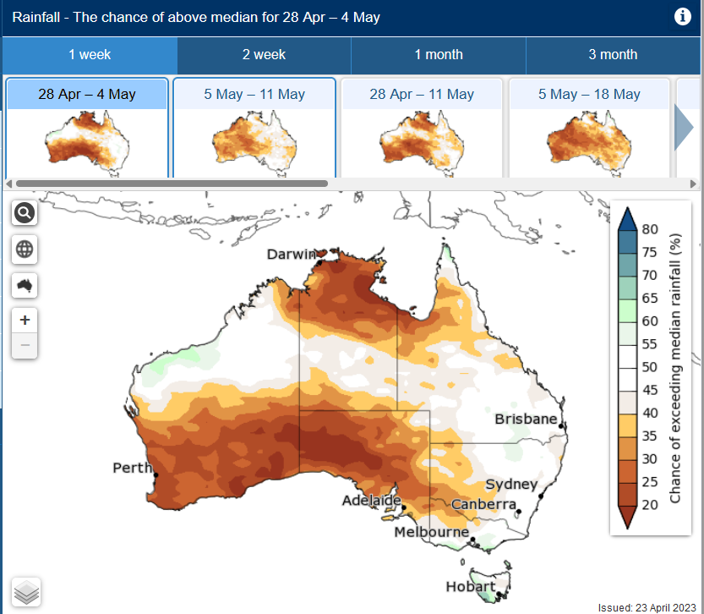
Foundational tools
Chance of above median…
Notes:
Remember median = 50% of dataset. Above median or below median only tells us so much. Tools allow to dig deeper; if below median, how much below median can we expect? Is it a decile 3&4 or a decile 1&2 type outlook?

Slide 24
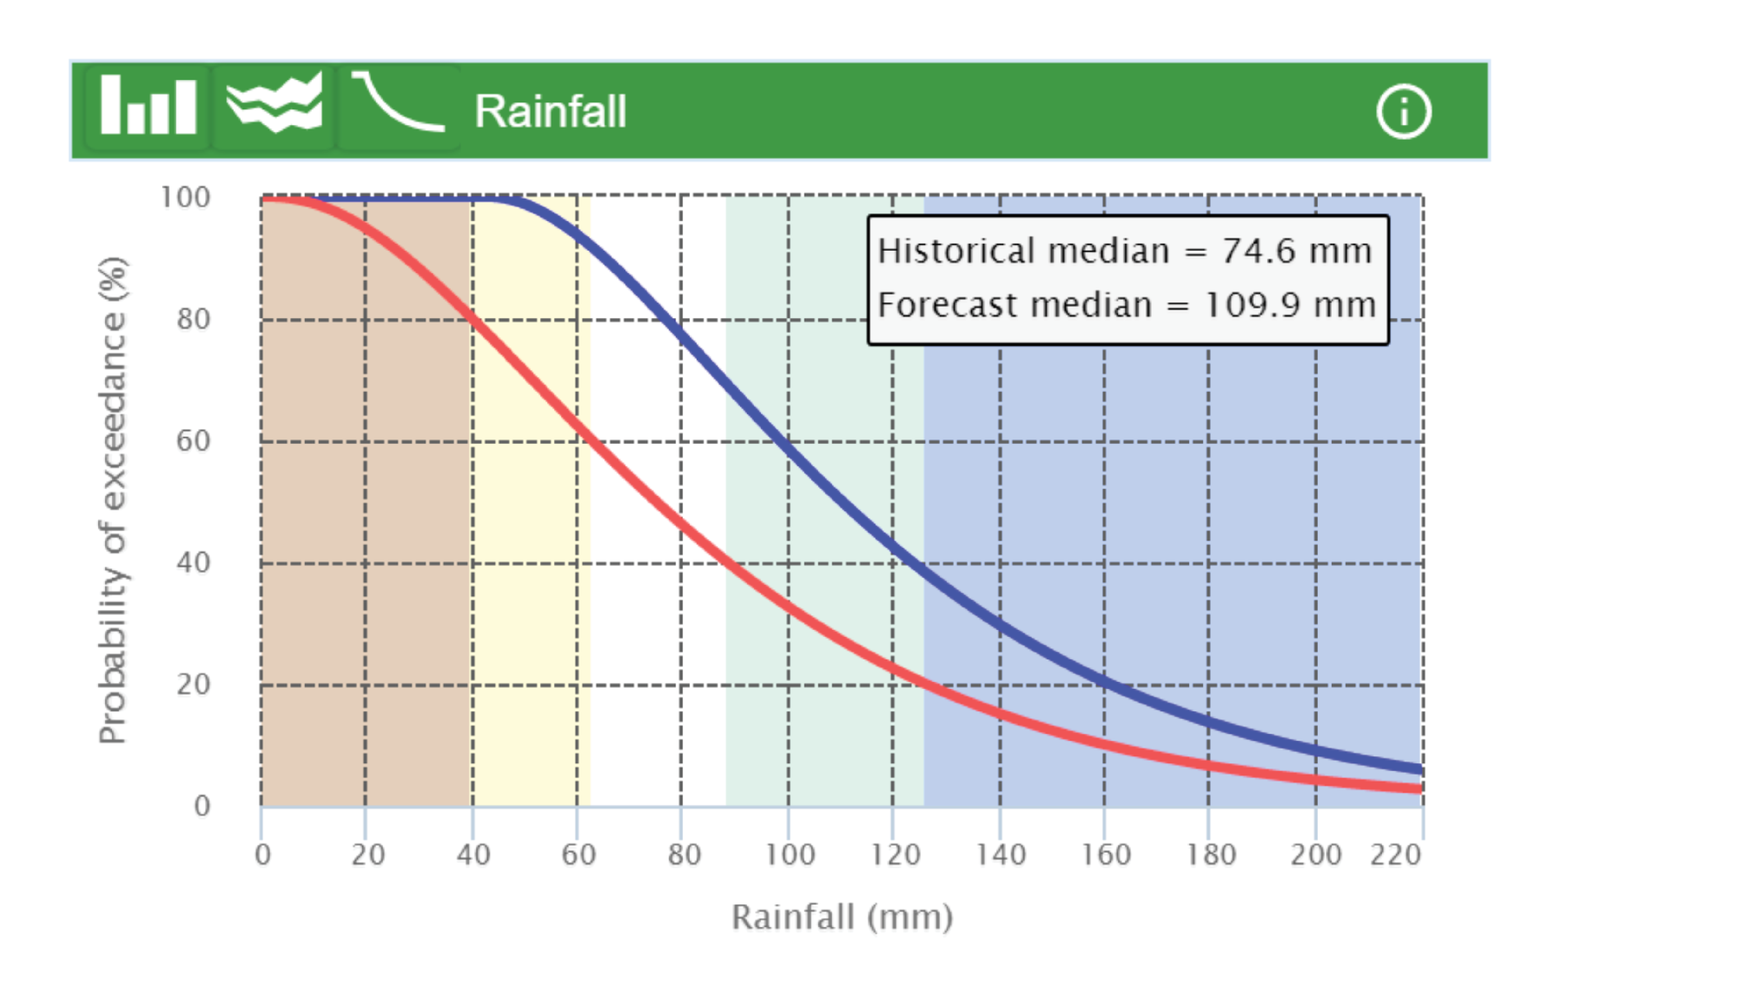
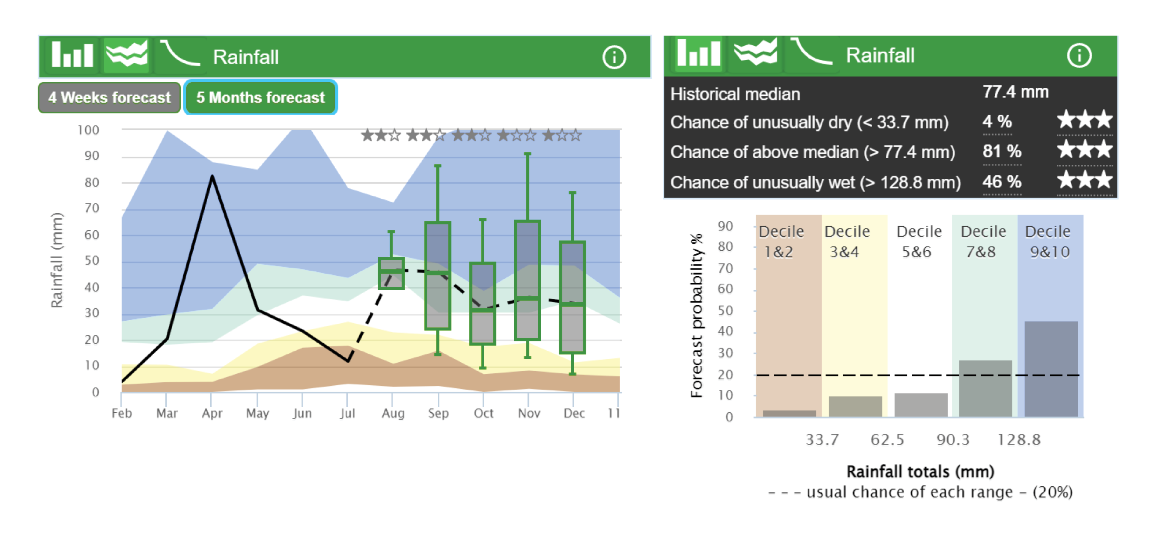
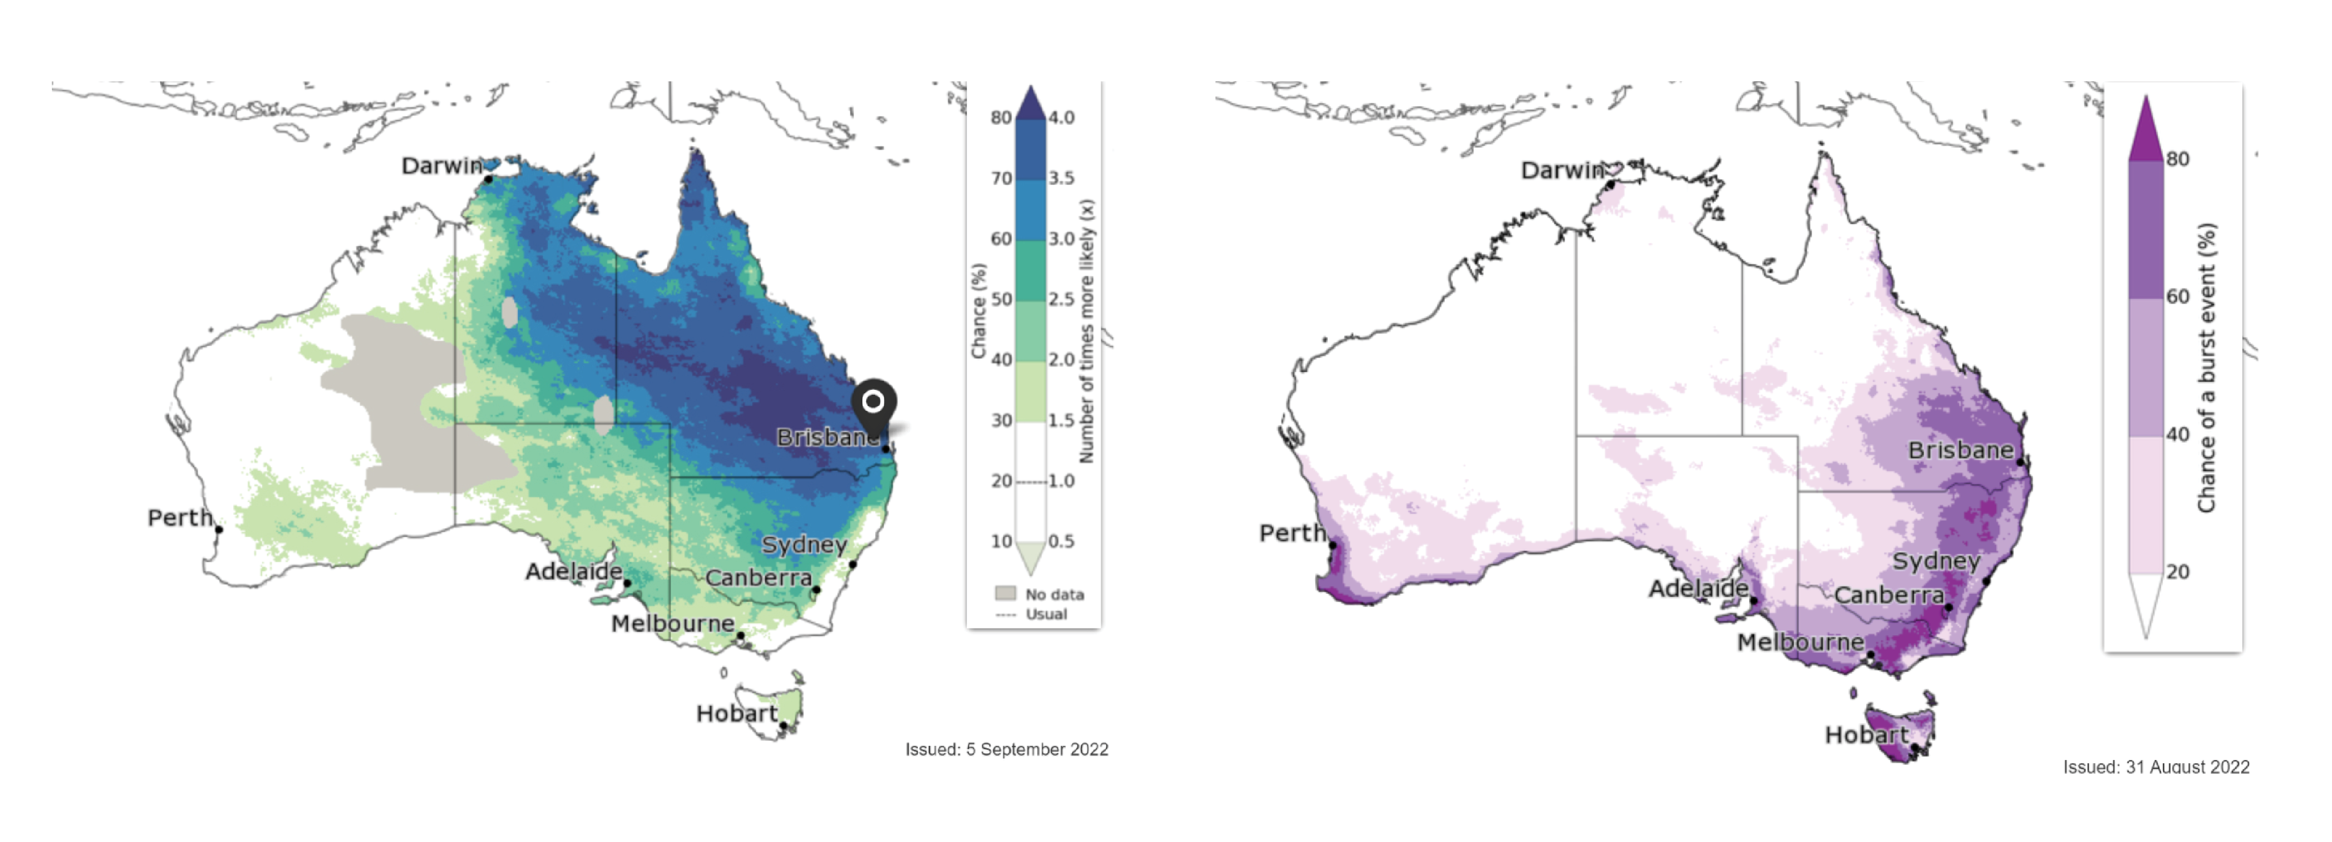
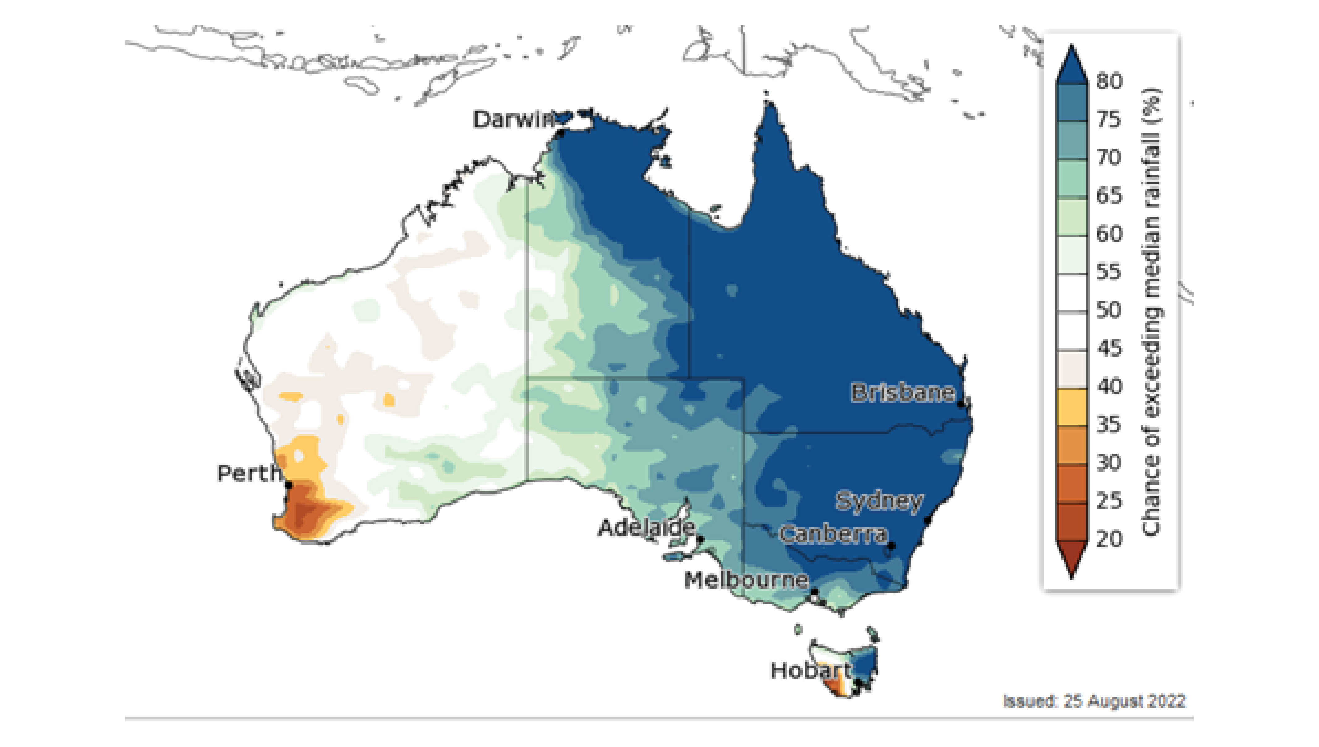
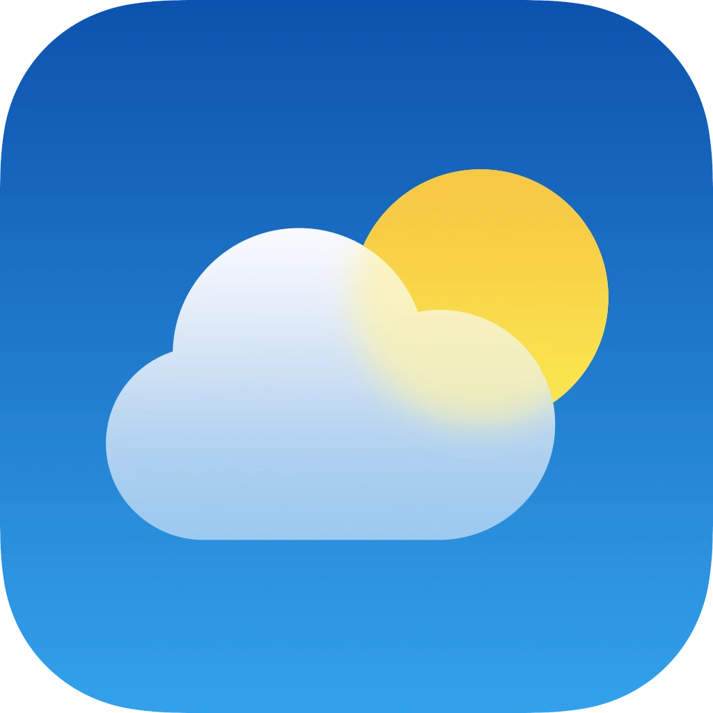
Increasing complexity…
• Probability of exceedance graph
• Decile bar chart (LHS)
• Timeline graph (RHS)
Increased information
• Chance of extremes graph (LHS)
• Chance of 3-day totals graph (RHS)
• Chance of exceeding media rainfall
Increased time and effort to understand

Slide 25
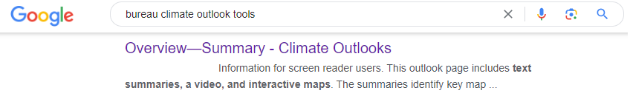
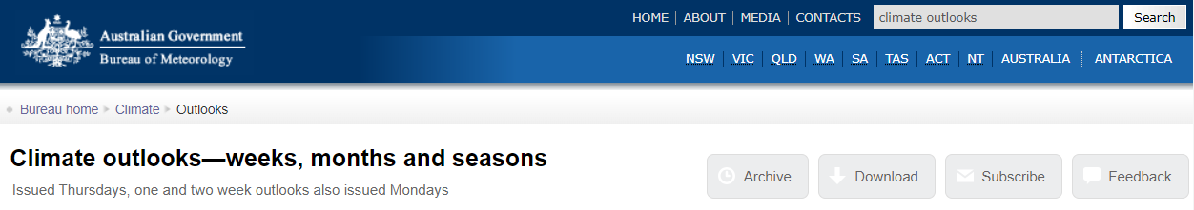
Finding the tools
Workbook
Page 38
Notes:
You can point out that for ease the search functions in google or on the website of the Bureau can be used. When you step through the case studies and run the tools live, you can take the opportunity to showcase how to access the tools from the Bureau’s homepage. This is also outlined in the workbook in the appendix.

Slide 26
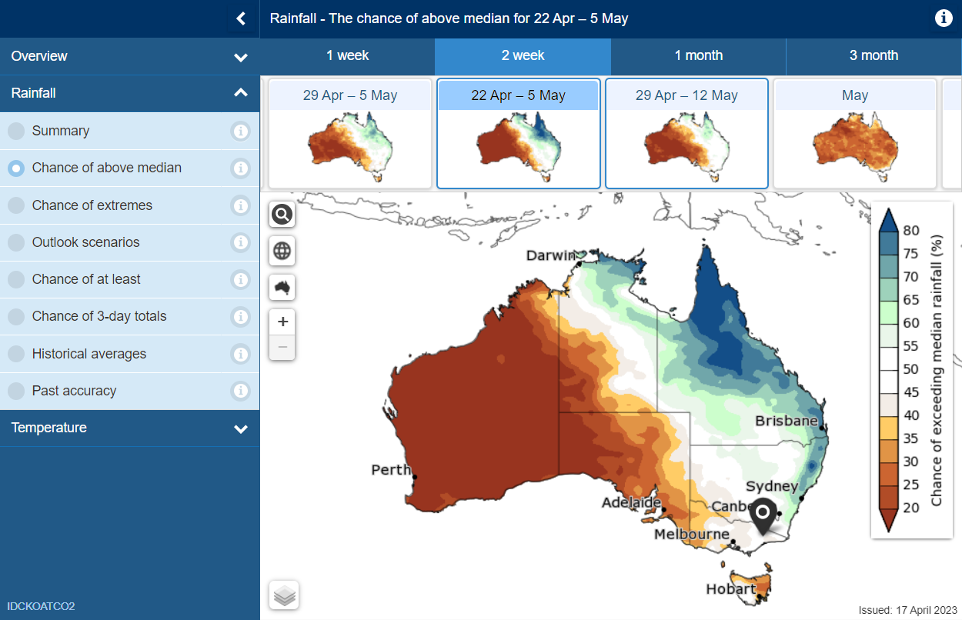
Chance of above median maps
Workbook
Page 13
In preparation for your workshop, please add in a more recent snapshot for your area!

Slide 27
The chance of extremes map
Workbook
Page 13
Shows the predictions for unusually high and low rainfall or temperatures over one week, two weeks, one month or three months.
In preparation for your workshop, please add in a more recent snapshot for your area!
Notes:
Important to highlight – the extremes map gives an instant overview of whether to dig deeper using the other tools or not.

Slide 28
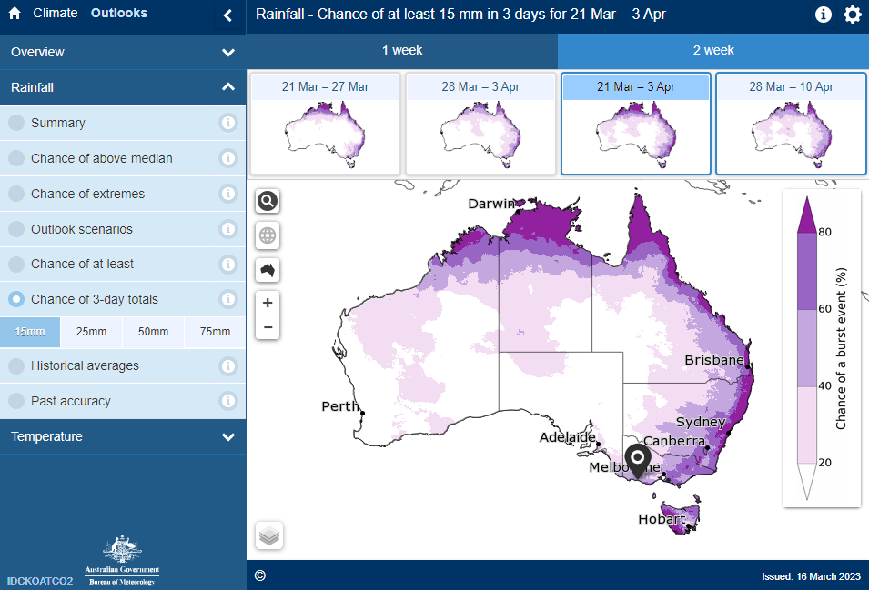
Chance of 3-day totals map
Workbook
Page 15
Shows the chance of receiving ‘at least’ a given amount of rainfall total over three consecutive days in a specified period of time
In preparation for your workshop, please add in a more recent snapshot for your area!

Slide 29
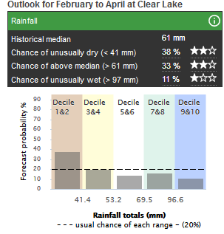
Decile bar charts
Workbook
Page 15
In preparation for your workshop, please add in a more recent snapshot for your area!
Location-specific decile bars for rainfall and temperature
Stars show past accuracy

Slide 30
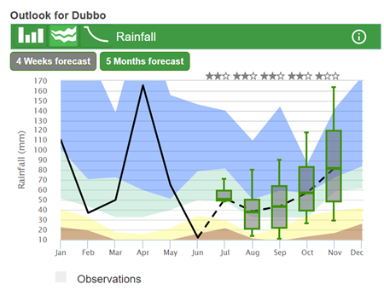
Timeline graphs
Workbook
Page 16
Location-specific timeline of recent climatic observations from the previous weeks and months, against historic averages
In preparation for your workshop, please add in a more recent snapshot for your area!

Slide 31
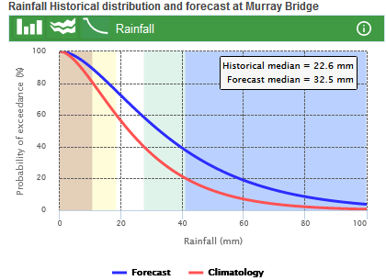
Probability of exceedance
Workbook
Page 16
Represents the forecast and historical data of a certain location for a particular rainfall total
In preparation for your workshop, please add in a more recent snapshot for your area!

Slide 32
Using the five FWFA tools with case studies
Notes:
Start with running through the case study you have shared in the pre-learning. This will prompt you to showcase some tool functionality real-time, and open up for participants to join in with questions. Make sure you reinforce that heatwaves and frosts are not something the tools can tell us anything about.

Slide 33

Key messages
Making climate-risk decisions in farming is like playing poker
it is decision making under uncertainty.
The four weather extremes of most interest to farmers are heat, cold, wet and dry.
Meaningful interpretation of forecasting information enables better decision making.

Slide 34
Key messages
The 5 FWFA climate outlook tools help plan operations past weather forecast by including decile distribution and their likelihood.
There are two types of tools:
  Australia-wide maps (the chance of extremes and 3-day totals)
  Location-specific graphs (decile bar charts, timeline graph and probability of exceedance)
They build on the Chance of above median maps.

Slide 35
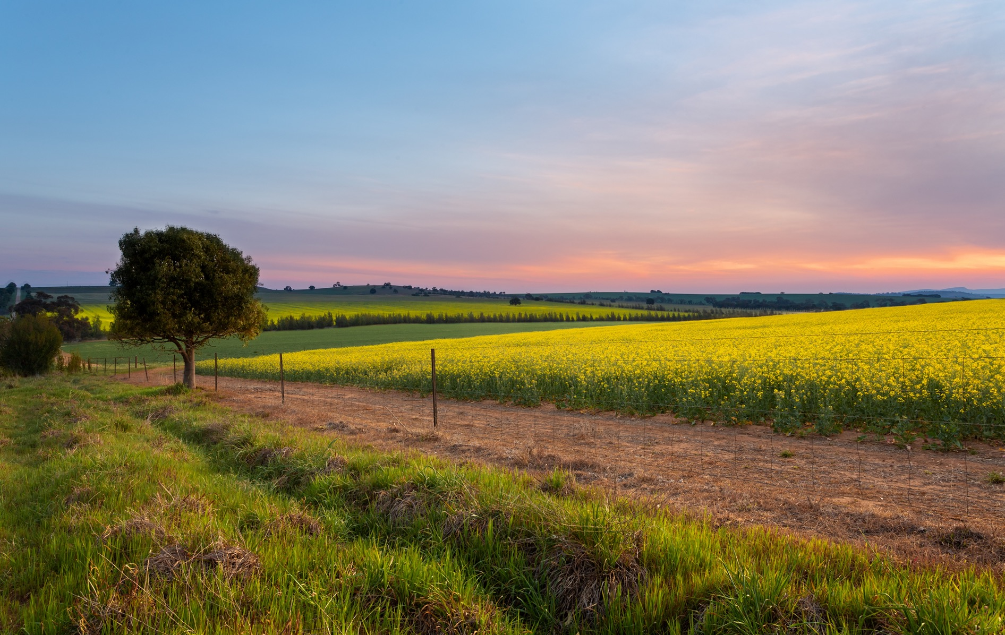

Questions, comments?

Slide 36

Using the tools for decision making
Notes:
In this section the focus is on how participant could be using the information.
Key points here is that you might come to the conclusion the tools aren’t telling you enough to worry about. Remember “too good to ignore, not good enough to be sure” (Peter Hayman, SARDI)

Slide 37
Local application
Workbook
Chapter 3
Which extremes are relevant for our location and industry?
Notes:
Use your insights from our break-out room in session 2 where we discussed these two questions:
How could you assist farmers in linking the tool outputs with identifying specific risks or challenges that extreme weather events could mean for them?
What approaches might you use to enable farmers to use the FWFA outputs to support decision making to mitigate extreme events?
Consider a three-stage approach:
What are the risks and challenges to your business, associated with extreme weather events?
What decisions do you have to make in case of such extreme weather event?
How can these tools help in your decision making?
TIP: participants might tend to start talking operational rather than tactical. As deliverer you want to try and keep the conversation at tactical level to prevent going off on a tangent about methods and preferred farming practices.

Slide 38
Local application
In preparation for your workshop, please add material relevant for your location and industry!
Add material relevant for your location and industry here
Notes:
Consider using information out of chapter 3 to help you tailor this section to the industry you’re delivering to.
Consider using our tips for delivery and other workshop-delivery-information in chapter 5.

Slide 39
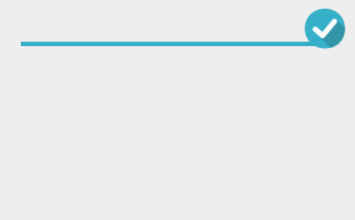
Further resources
Workshop booklet
Follow-up email with links to key information
  Bureau’s website and links to the 5 tools
  Agriculture Victoria’s online course
  Northern Australia Climate Program’s online course
  The Climatedogs website
You’re welcome to e-mail further questions to
agriculture@bom.gov.au

Slide 40
Evaluation
Please complete the anonymous survey so we can further improve future workshops!
Notes:
Feel free to use your own evaluation methods to gather feedback and improve your workshop delivery.
Any feedback on the tool functionality itself? Please pass it on to agriculture@bom.gov.au

Slide 41
Thank you

